Slide 1

Meteorites
By: Sam Rose, Aiden Lee, Tim Philippsen, and Jordyn Plotnik

Slide 2

Agenda
Review Datasource and objective
Discuss findings from our data
Summary
Q&A

Slide 3
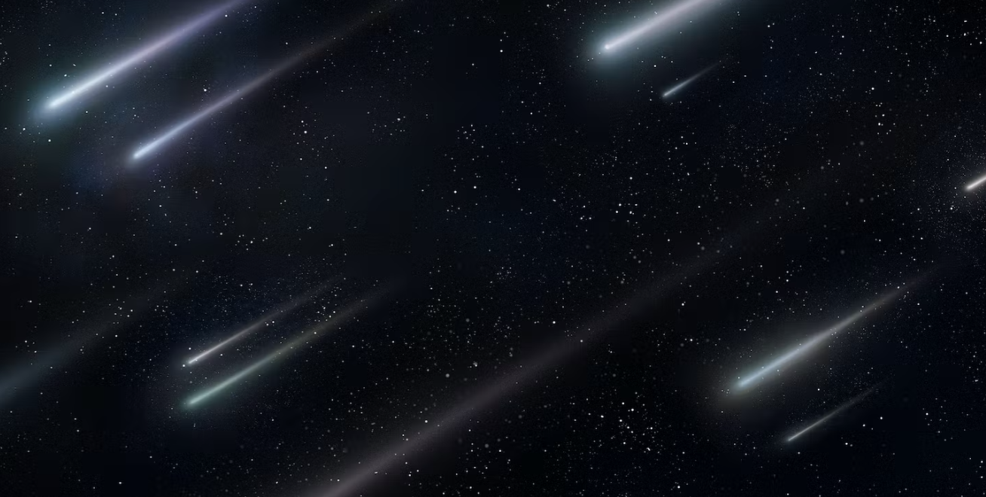
Objective
Data: Meteorite Landings
Source: https://catalog.data.gov/dataset/meteorite-landings/resource/389dab1c-1e2e-4b13-83bf-d05a0219fe3e
Objective: Use the data to answer these questions:
Where are meteorites falling and being found?
Are there more meteorites being found now, compared to older-less populated century’s?
What are the most commonly found types of meteorites?

Slide 4

Map
Our group decided to create a cluster map to showcase the meteorites that fell or were found all over the world. This map will be presented during our dashboard showing.
“Fell Markers”
180 fell in North America (including Hawaii)
5 fell in between South America and North America
56 fell in South America
119 fell in Africa
321 fell in Europe
350 fell in Asia
15 fell in between Asia and Africa
36 fell in between Europe and Africa
15 fell in Australia

Slide 5
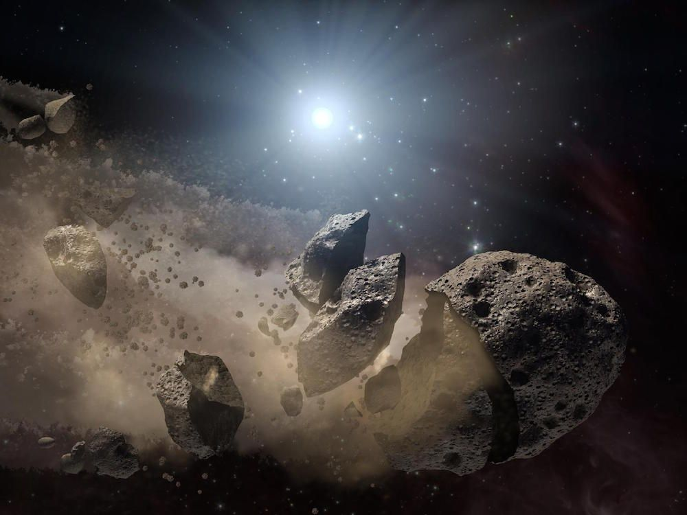
Map (continued)
“Found” markers
1640 found in North America (including Hawaii)
494 found in South America
2711 found in Africa
6214 found in Atlantic Ocean
175 found in Europe
3324 found in Asia
635 found in Australia
22,111 found in Antarctica

Slide 6
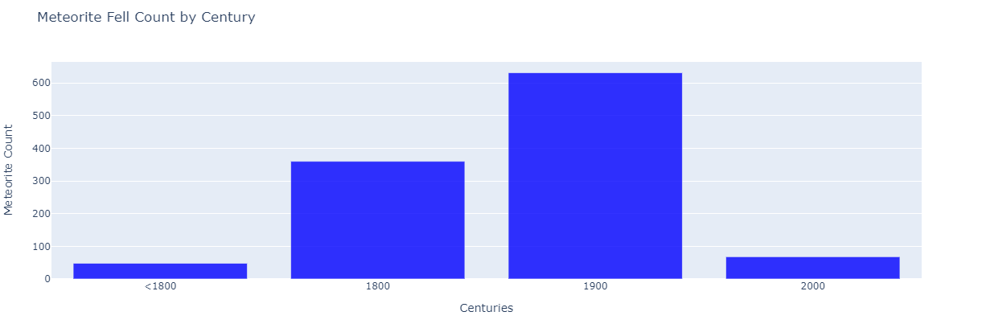
Graphs for Meteorites that were “Fell” by Century
“Fell” - Meteorites that are collected soon after being witnessed to fall.

Slide 7
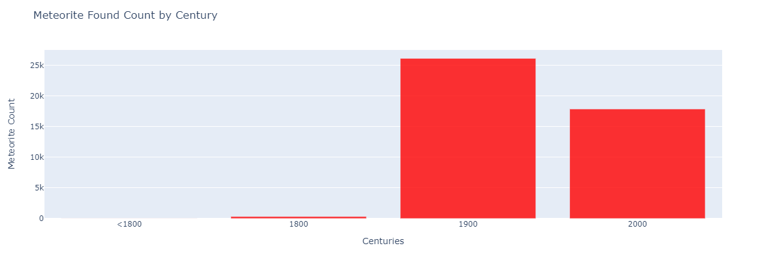
Graphs Meteorites that were “Found” by Century
“Found” - Meteorites that were found overtime on Earth.

Slide 8
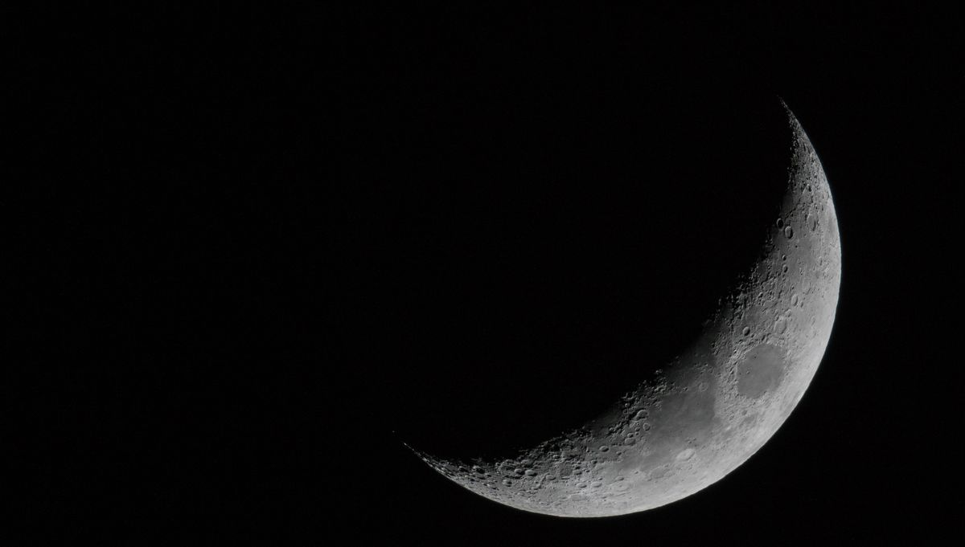
The Types of Meteorites
Achondrite
Stony meteorites that do not contain chondrules.
Chondrite
Stony meteorite that is formed when various types of dust and small grains accumulate to create a primitive asteroid.
Iron-Meteorite
Type of meteorite that contains an insane amount of meteoric iron.
Stony-Iron Meteorite
Type of meteorite that contains equal amounts of meteoric iron and rock forming minerals.
Other
Not an actual type of meteorite, just based from data/csv.
Can mean that they are classified into sub groups of the 4 main types of meteorites.
Unknown
Meteorites that have a common unknown origin.
Not a type of meteorite., just based from data/csv.
Notes:
+

Slide 9

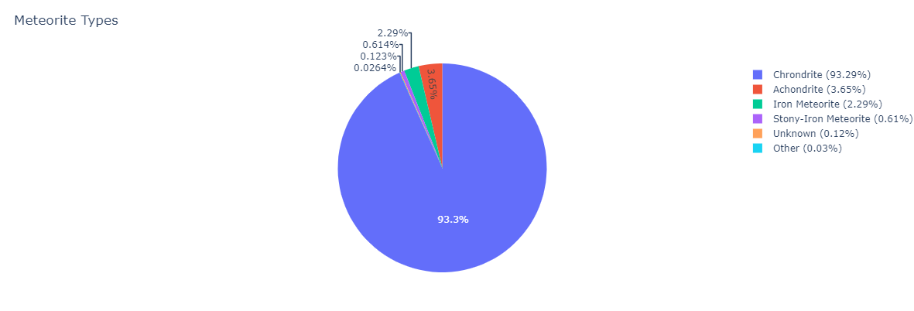
The types of meteorites data analysis

Slide 10

Review Website

Slide 11

Conclusion
In conclusion we were able to use our data to answer the below questions:
Where are meteorites falling and being found?
Are there more meteorites being found now, compared to older-less populated century’s?
What are the most commonly found types of meteorites?
Data limitations -
More data in past 200 years, compared to earlier years
More data points: Month, Continent, etc.
Isolating duplicate data points
If we had more time…
We would add more variables to our map. Mostly we wanted to add different colored markers for fell and found
We would create more visuals in plotly utilizing the categories created in SQL

Slide 12

Q&A

